Slide 1

IoT Botnet Detection and Classification using
Machine Learning Algorithms
Authors:
Pham Van Quan¹, Ngo Van Uc¹,
Do Phuc Hao^{2,3}, Nguyen Nang Hung Van⁴
¹ Dong A university, Da Nang, Viet Nam
² The Bonch-Bruevich Saint-Petersburg State University of Telecommunications, Saint- Petersburg, Russian Federation
³ Da Nang university of Architecture, Da Nang, Viet Nam
⁴ Danang University of science and Technology, Da Nang, Viet Nam
Da Nang July 28th, 2023

Slide 2
CONTENTS
INTRODUCTION
Introduction
Motivation
2. PROPOSED MODEL
Introduction and processing dataset
3. EXPERIMENT AND PERFORMANCE EVALUATION
Results of experiments
Explanation and discussion the evaluation
4. FUTURE RESEARCH DIRECTIONS AND CONCLUSIONS
Da Nang July 28th, 2023

Slide 3
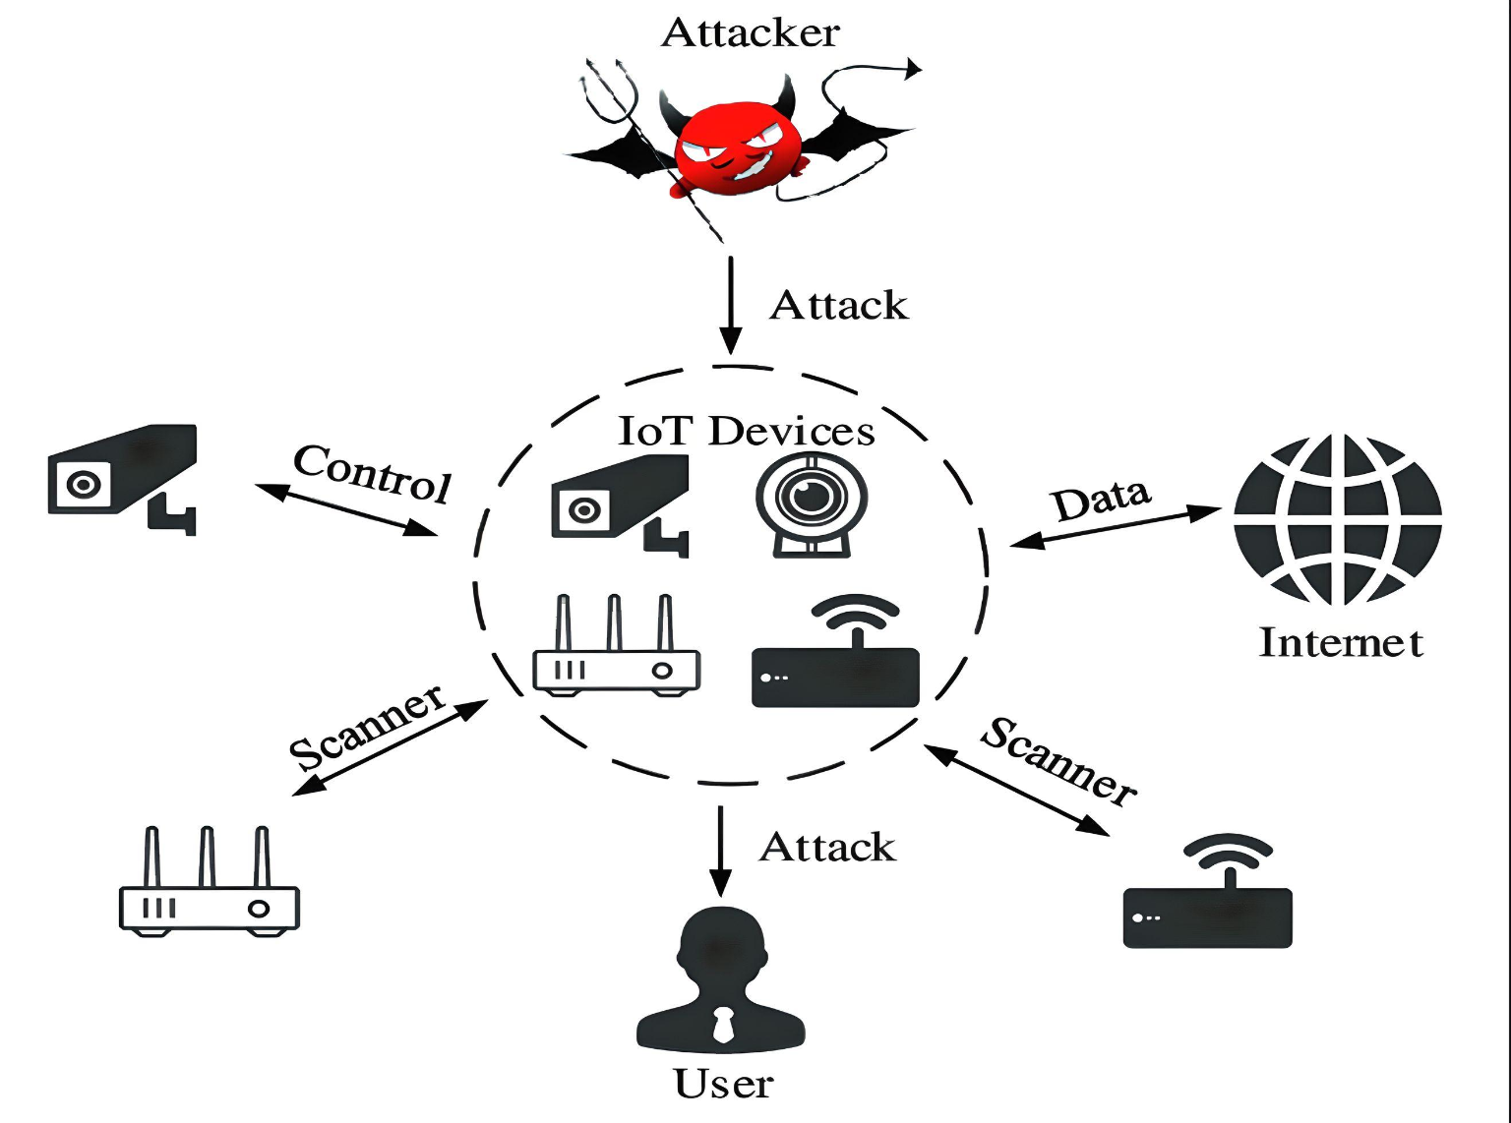
1. INTRODUCTION
2. PROPOSED MODEL
3. EXPERIMENT PERFORMANCE EVALUATION
4. FUTURE RESEARCH DIRECTION AND CONCLUSIONS
1.1 Motivation
1.2 Research Objective
MOTIVATION
According to a report by the security firm McAfee, there are about 150,000 cyberattacks per day. Of these, about 10% are attacks on IoT systems.
Common and sophisticated cyber attacks
Challenges in IoT service deployment, information security, threats to users…
Figure 1: IoT Botnets Attacks
1
Da Nang July 28th, 2023
Source: internet

Slide 4
1. INTRODUCTION
2. PROPOSED MODEL
3. EXPERIMENT PERFORMANCE EVALUATION
4. FUTURE RESEARCH DIRECTION AND CONCLUSIONS
1.1 Significance
1.2 Research Objective
MOTIVATION
Ineffective against new attacks
Inflexible and difficult to adapt to new threats
Disadvantages of traditional security systems
Hard to automate the process
Low accuracy
Complex and expensive to deploy and maintain
Low speed
2
Da Nang July 28th, 2023

Slide 5
1. INTRODUCTION
2. PROPOSED MODEL
3. EXPERIMENT PERFORMANCE EVALUATION
4. CONCLUSIONS AND FUTURE RESEARCH DIRECTION
1.1 Motivation
MOTIVATION
Handling large and complex data
Automatically detecting new attacks
WHY using ML for Cyber Security?
High Speed
High Accuracy
High performance and times saving
Continuous learning and improvement
Building a ML model for Cyber Security
3
Da Nang July 28th, 2023

Slide 6
1. INTRODUCTION
2. PROPOSED MODEL
3. EXPERIMENT PERFORMANCE EVALUATION
4. CONCLUSIONS AND FUTURE RESEARCH DIRECTION
2.1 Proposed model
2.2 The IoT-23 dataset
2.3 Real-time data in network inviroment
PROPOSED MODEL
IoT-23
dataset
ML: DT, RF, kNN, XGB
Model trained
Training
Data
preprocessing
Data partition
Validation
Testing
Result
Figure 2: Proposed Model
4
Da Nang July 28th, 2023

Slide 7
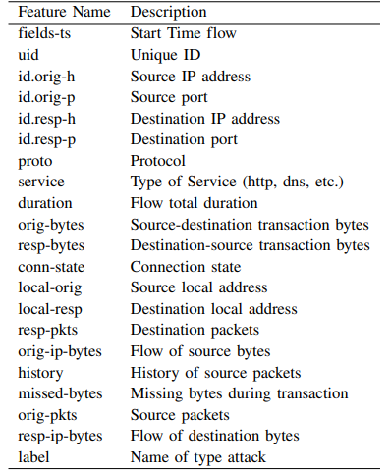
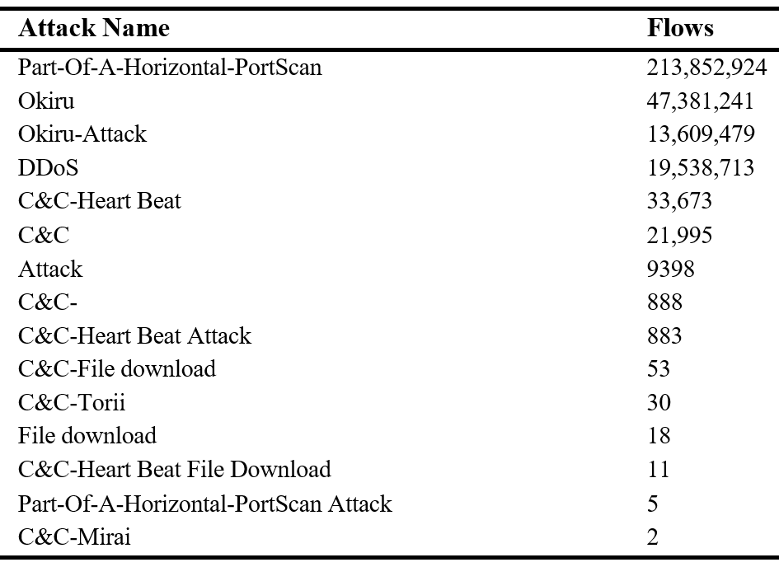
1. INTRODUCTION
2. PROPOSED MODEL
3. EXPERIMENT PERFORMANCE EVALUATION
4. CONCLUSIONS AND FUTURE RESEARCH DIRECTION
2.1 Proposed model
2.2 The IoT-23 dataset
2.3 Real-time data in network inviroment
THE IoT-23 DATASET
Developed by the Stratosphere, published in 2020.
The IoT-23 dataset consists of 23 captures: 20 malware captures, 3 benign captures.
It includes almost 300.000.000 records and 20 features.
Table 1: The number of attacks types
Table 2: The feature of dataset
5
Da Nang July 28th, 2023

Slide 8
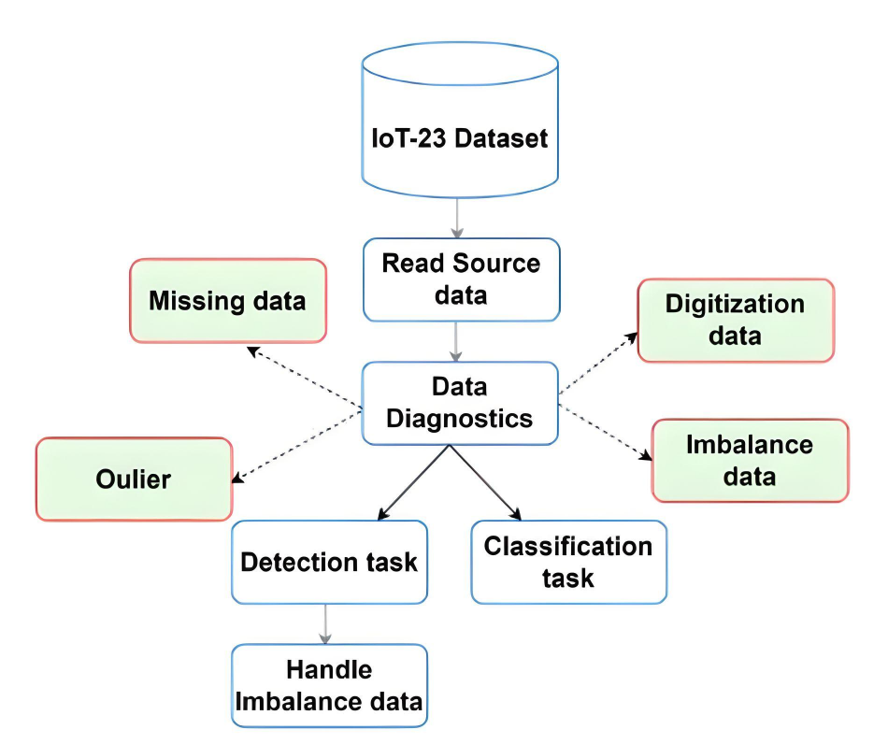
1. INTRODUCTION
2. PROPOSED MODEL
3. EXPERIMENT PERFORMANCE EVALUATION
4. CONCLUSIONS AND FUTURE RESEARCH DIRECTION
2.1 Proposed model
2.2 The IoT-23 dataset
2.3 Real-time data in network inviroment
PREPROCESSING DATASET IoT-23
Data diagnostics and Dataset check
Missing data: None
Outlier: Almost None
Data type:
Numeric format
Non-numeric format
Imbalance data
Detection task
Classification task
6
Figure 3: Preprocessing Model
Da Nang July 28th, 2023

Slide 9
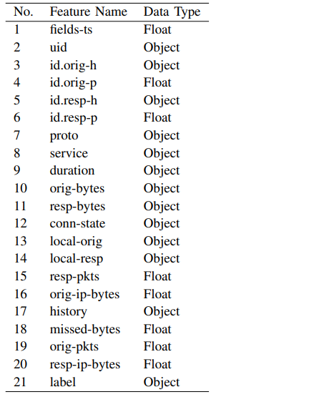
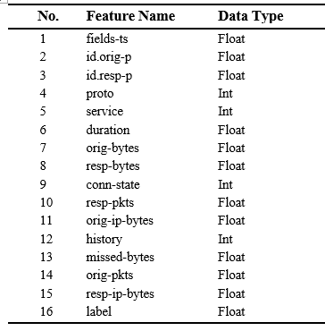
1. INTRODUCTION
2. PROPOSED MODEL
3. EXPERIMENT PERFORMANCE EVALUATION
4. CONCLUSIONS AND FUTURE RESEARCH DIRECTION
2.1 Proposed model
2.2 The IoT-23 dataset
2.3 Real-time data in network inviroment
THE IOT-23 DATASET
Handling the data type of feature
Cannot be encoded
Amenable be encoding
Label encoding
7
Table 3: The data type before handling
Table 4: The data type after handling
Da Nang July 28th, 2023

Slide 10

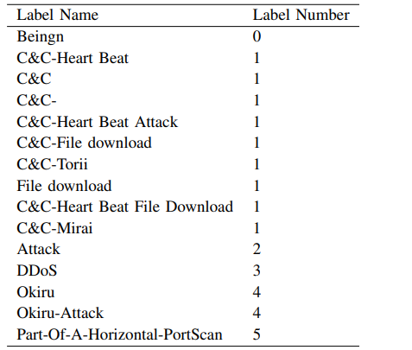

1. INTRODUCTION
2. PROPOSED MODEL
3. EXPERIMENT PERFORMANCE EVALUATION
4. CONCLUSIONS AND FUTURE RESEARCH DIRECTION
2.1 Proposed model
2.2 The IoT-23 dataset
2.3 Real-time data in network inviroment
THE IOT-23 DATASET
Handling the Data Type of Label and Imbalance Data
Table 5: Lables for detection task before resample
Resample
Table 6: Lables for detection task after resample
Table 7: Lables for classification task
8
Da Nang July 28th, 2023

Slide 11

1. INTRODUCTION
2. PROPOSED MODEL
3. EXPERIMENT PERFORMANCE EVALUATION
4. CONCLUSIONS AND FUTURE RESEARCH DIRECTION
2.1 Proposed model
2.2 Introduce IoT-23 dataset
2.3 Preprocessing data IoT-23
2.4 Real-time data in network inviroment
REAL-TIME DATA IN A NETWORK ENVIRONMENT
Real-time
data
Data-1
Model
Result-1
data collection
preprocessing
Stream
data
Data-2
Model
Result-2
Data-3
Model
Result-3
. . .
Data collection and threading into trained models
=> real-time results
Model
Data-n
Result-n
9
Figure 4: Handling Streaming Data in Real-time
Da Nang July 28th, 2023

Slide 12
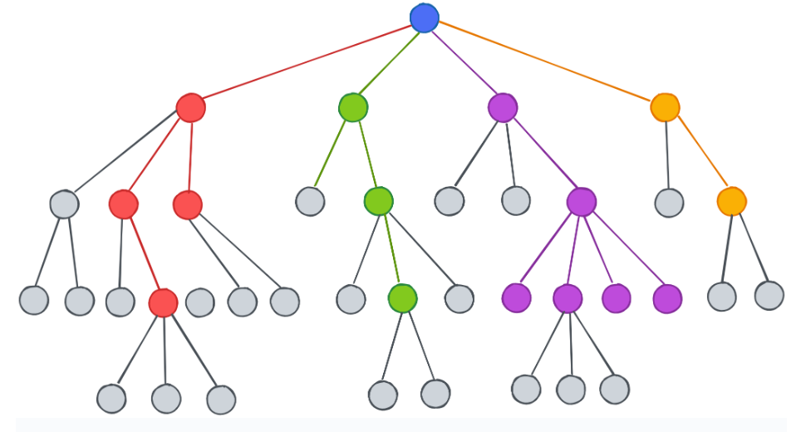
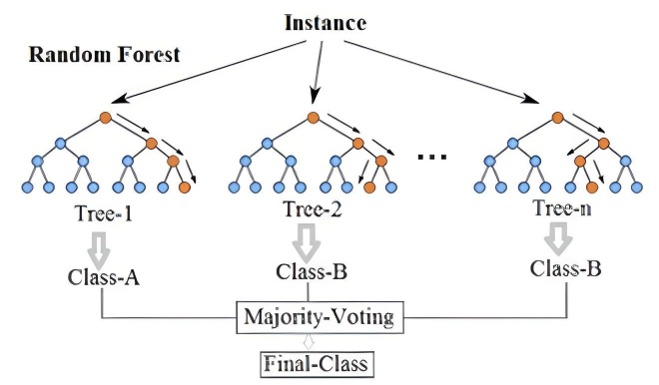
1. INTRODUCTION
2. PROPOSED MODEL
3. EXPERIMENT PERFORMANCE EVALUATION
4. CONCLUSIONS AND FUTURE RESEARCH DIRECTION
2.1 Proposed model
2.2 Introduce IoT-23 dataset
2.3 Preprocessing data IoT-23
2.4 Real-time data in network inviroment
2.5 Algorithms
ALGORITHMS
Decision Tree
Random Forest
Mechanism of action to get the result based on selecting nodes using the Entropy value to make decisions
Mechanism of action involves creating multiple decision trees during training and combining their predictions to make more accurate and robust predictions. (Voting)
Source: internet
Source: internet
Figure 5: Decision Tree Model
Figure 6: Random Forest Model
10
Da Nang July 28th, 2023

Slide 13
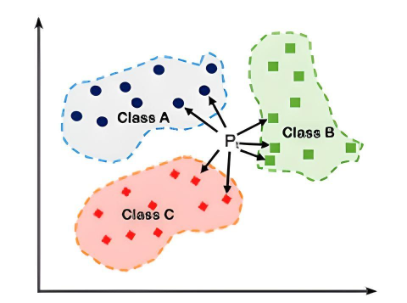
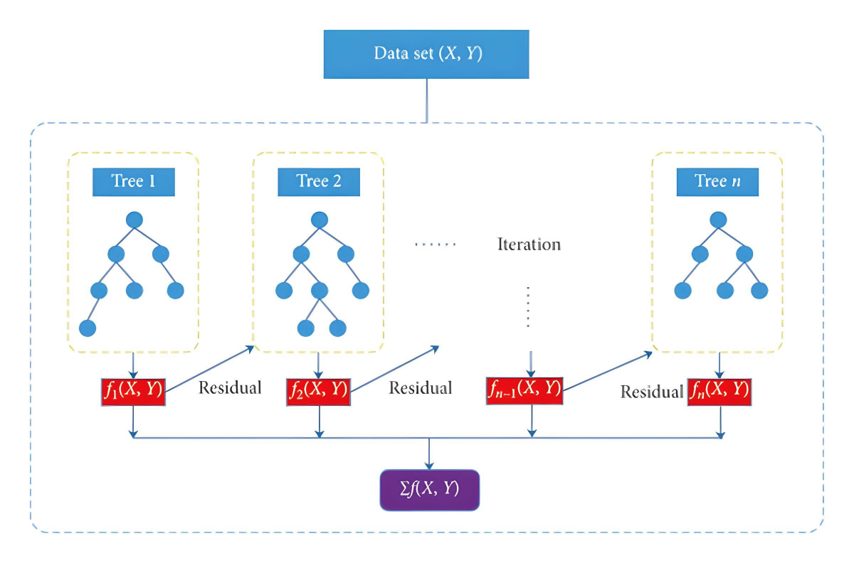
1. INTRODUCTION
2. PROPOSED MODEL
3. EXPERIMENT PERFORMANCE EVALUATION
4. CONCLUSIONS AND FUTURE RESEARCH DIRECTION
2.1 Proposed model
2.2 Introduce IoT-23 dataset
2.3 Preprocessing data IoT-23
2.4 Real-time data in network inviroment
2.5 Algorithms
ALGORITHMS
KNN
XGBoost
Mechanism of action to get the result based on the nearest K points.
Mechanism of action involves iteratively building a robust model by combining weak learners (typically decision trees) in an additive manner.
Source: internet
Figure 7: KNN Model
Source: internet
11
Figure 8: XGB Model
Da Nang July 28th, 2023

Slide 14
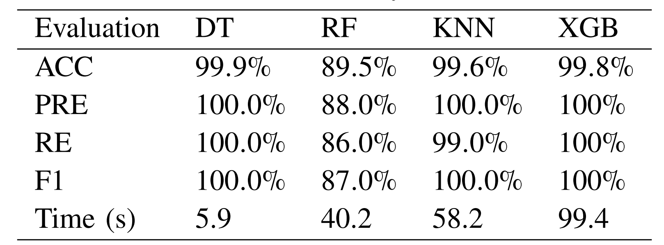
1. INTRODUCTION
2. PROPOSED MODEL
3. EXPERIMENT & PERFORMANCE EVALUATION
4. CONCLUSIONS AND FUTURE RESEARCH DIRECTION
3.1 Experimental results
3.2 Evaluating the results
EXPERIMENTAL RESULTS
Detection of attacks:
Table 8 : some metrics of binary classification
12
Da Nang July 28th, 2023

Slide 15
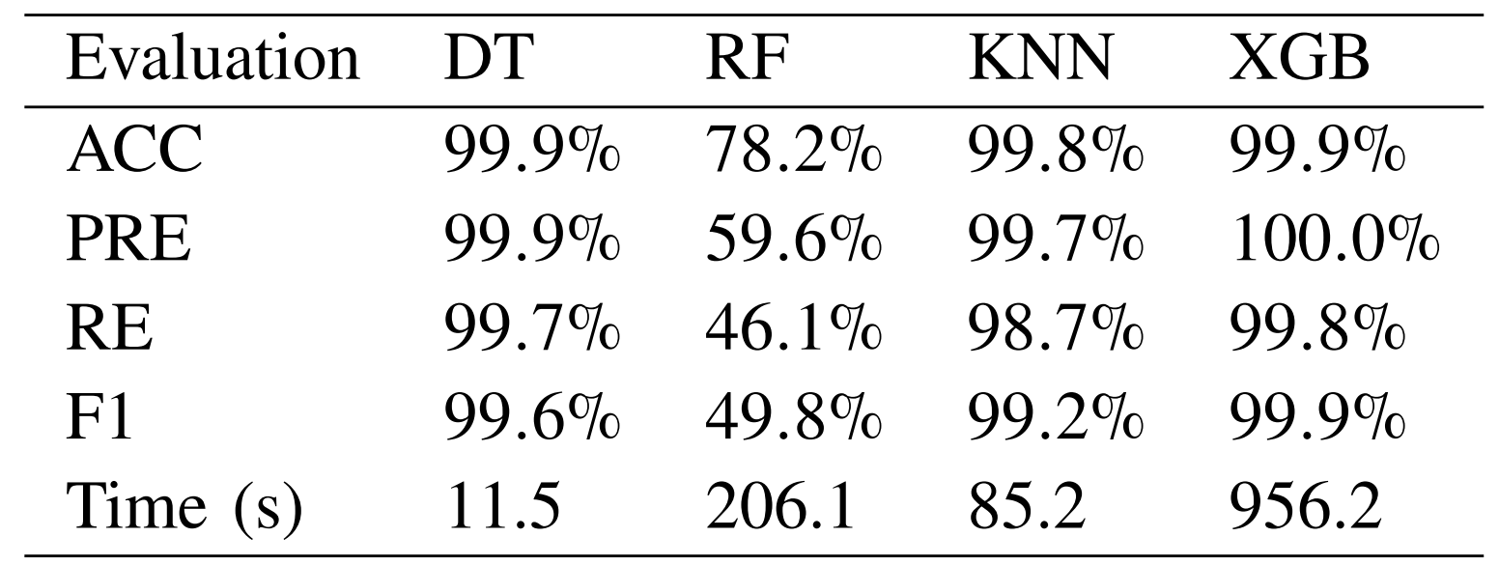
1. INTRODUCTION
2. PROPOSED MODEL
3. EXPERIMENT & PERFORMANCE EVALUATION
4. CONCLUSIONS AND FUTURE RESEARCH DIRECTION
3.1 Experimental results
3.2 Evaluating the results
EXPERIMENTAL RESULTS
Multi-classification attacks:
Table 9: some metrics of multi-classification
13
Da Nang July 28th, 2023

Slide 16
1. INTRODUCTION
2. PROPOSED MODEL
3. EXPERIMENT & PERFORMANCE EVALUATION
4. CONCLUSIONS AND FUTURE RESEARCH DIRECTION
3.1 Experimental results
3.2 Evaluating the results
EVALUATING THE RESULTS
The DT and XGB algorithms outperform other algorithms, with DT being a good choice for binary classification. DT excels particularly in multi-class classification
The DT algorithm exhibits the best time performance, making it suitable for continuous and fast processing in binary classification tasks
DT is powerful in multi-class classification, and KNN is also a viable option
The RF algorithm has not shown satisfactory performance in detection and classification
Overall, DT is the algorithm with the best performance on both tasks through evaluation and time.
14
Da Nang July 28th, 2023

Slide 17

1. INTRODUCTION
2. PROPOSED MODEL
3. EXPERIMENT & PERFORMANCE EVALUATION
4. CONCLUSIONS AND FUTURE RESEARCH DIRECTION
4.1 Conclusions
4.2 Future research directions
FUTURE RESEARCH DIRECTIONS
Model:
Continue researching and developing other machine learning algorithms and deep learning to improve performance.
Data:
Extract the best features that have the most influence on the results, then train and evaluate the results.
In the future, we plan to expand this dataset by combining it with other datasets through the best features
15
Da Nang July 28th, 2023

Slide 18

1. INTRODUCTION
2. PROPOSED MODEL
3. EXPERIMENT & PERFORMANCE EVALUATION
4. CONCLUSIONS AND FUTURE RESEARCH DIRECTION
4.1 Conclusions
4.2 Future research directions
CONCLUSIONS
Introduction to IoT Botnet Attacks and Motivation for doing this research.
Introduction the IoT-23 Dataset and the careful analysis and processing of dataset for preparing Detection task and Classification task.
We have done the research and given the results. In summary, DT is the algorithm with the best performance on both tasks through evaluation and time.
In addition to our results, we also propose future research directions that are approached in two parts: model and dataset.
16
Da Nang July 28th, 2023

Slide 19
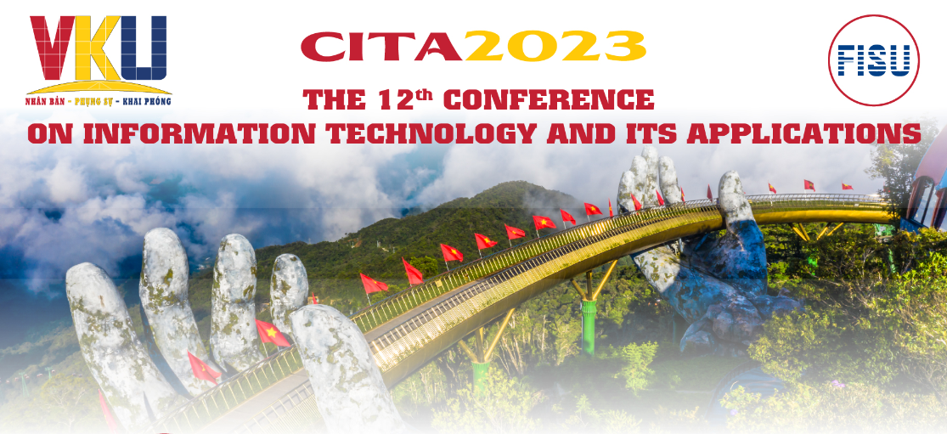
THANKS FOR LISTENING!

